Slide 1
CHAPTER 3
APPLICATIONS OF DIFFERENTIATION

Slide 2
Contents
4.1. Related Rates
4.2. Linear Approximations and Differentials
4.3. Maxima and minima
4.4. The Mean value theorem
4.5. Derivatives and the shapes of Graphs
4.6. Limits at Infinity and Asymptotes
4.7. Applied Optimization Problems
4.9. Newton’s Method
4.10. Antiderivatives

Slide 3
APPLICATIONS OF DIFFERENTIATION
4.1 Related Rates
In this section, we will learn:
How to compute the rate of change of one quantity
in terms of that of another quantity.

Slide 4
RELATED RATES
Example 1
Air is being pumped into a spherical balloon so that its volume increases at a rate of 100 cm³/s.
How fast is the radius of the balloon increasing when the diameter is 50 cm?

Slide 5
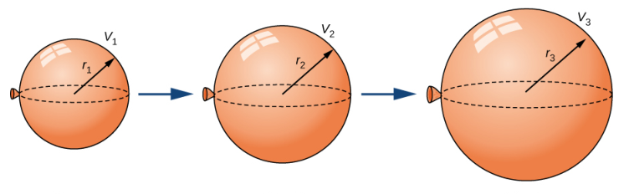
RELATED RATES
Example 1

Slide 6
RELATED RATES
Example 1
The key thing to remember is that rates of change are derivatives.
In this problem, the volume and the radius are both functions of the time t.
The rate of increase of the volume with respect to time is the derivative dV / dt.
The rate of increase of the radius is dr / dt.

Slide 7
RELATED RATES
Example 1
To connect dV/dt and dr/dt, first we relate V and r by the formula for the volume of a sphere:

Slide 8
Example 1
To use the given information, we differentiate each side of the equation with respect to t.
To differentiate the right side, we need to use the Chain Rule:

Slide 9
RELATED RATES
Example 1
Now, we solve for the unknown quantity:
If we put r = 25 and dV / dt = 100 in this equation, we obtain:
The radius of the balloon is increasing at the rate of 1/(25π) ≈ 0.0127 cm/s.

Slide 10
DIFFERENTIALS
Example 2
The radius of a sphere was measured and found to be 21 cm with a possible error in measurement of at most 0.05 cm.
What is the maximum error in using this value of the radius to compute the volume of the sphere?
Solution
If the radius of the sphere is r, then its volume is V = 4πr³/3.
If the error in the measured value of r is denoted by
dr = ∆r, then the corresponding error in the calculated value of V is ∆V.

Slide 11
DIFFERENTIALS
Example 2
This can be approximated by the differential
dV = 4πr²dr
When r = 21 and dr = 0.05, this becomes:
dV = 4π(21)² 0.05 ≈ 277
The maximum error in the calculated volume is about 277 cm³.

Slide 12
RELATIVE ERROR
Note
Relative error is computed by dividing the error by the total volume:
Thus, the relative error in the volume is about three times the relative error in the radius.

Slide 13
RELATIVE ERROR
Note
In the example, the relative error in the radius is approximately dr/r = 0.05/21 ≈ 0.0024 and it produces a relative error of about 0.007 in the volume.
The errors could also be expressed as percentage errors of 0.24% in the radius and 0.7% in the volume.

Slide 14
Example 2
A ladder 10 ft long rests against a vertical wall. If the bottom of the ladder slides away from the wall at a rate of 1 ft/s, how fast is the top of the ladder sliding down the wall when the bottom of the ladder is 6 ft from the wall?

Slide 15
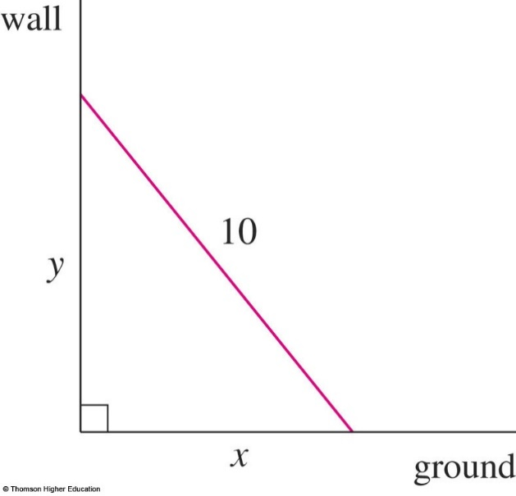
Example 2
We first draw a diagram and label it as in the figure.
Let x feet be the distance from the bottom of the ladder to the wall and y feet the distance from the top of the ladder to the ground.
Note that x and y are both functions of t (time, measured in seconds).

Slide 16
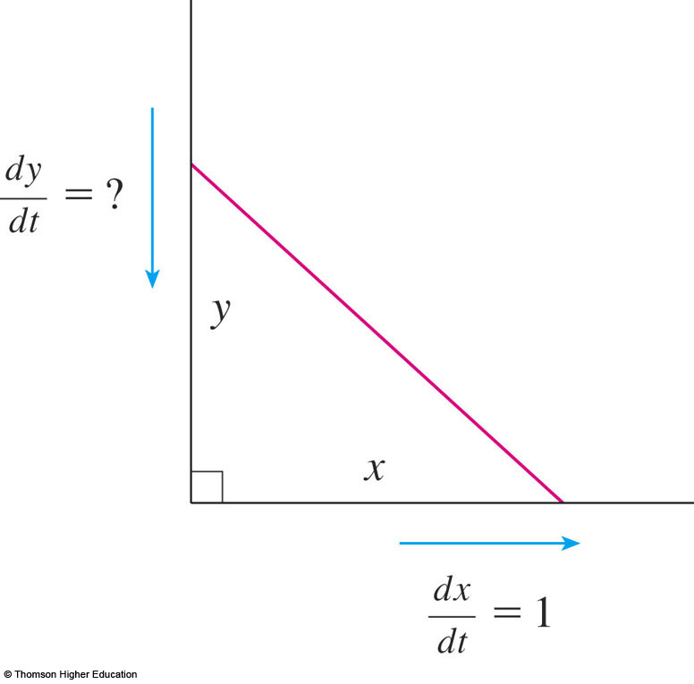
Example 2
We are given that
dx / dt = 1 ft/s
and we are asked
to find dy / dt when
x = 6 ft.

Slide 17
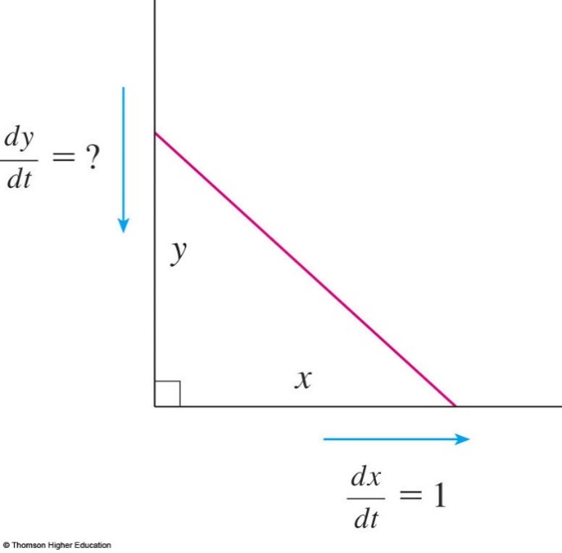
Example 2
In this problem, the relationship between x and y is given by the Pythagorean Theorem: x² + y² = 100

Slide 18
Example 2
Differentiating each side with respect to t using the Chain Rule, we have:
Solving this equation for the desired rate, we obtain:

Slide 19
Example 2
When x = 6 , the Pythagorean Theorem gives y = 8 and so, substituting these values and dx / dt = 1, we have:
The fact that dy / dt is negative means that the distance from the top of the ladder to the ground is decreasing at a rate of ¾ ft/s.
That is, the top of the ladder is sliding down the wall at a rate of ¾ ft/s.

Slide 20
Do yourself
The top of a ladder slides down a vertical wall at a rate of 0.15 m/s. At the moment when the bottom of the ladder is 3 m from the wall, it slides away from the wall at a rate of 0.2 m/s. How long is the ladder?
Two sides of a triangle are 4 m and 5 m in length and the angle between them is increasing at a rate of 0.06 rad/s. Find the rate at which the area of the triangle is increasing when the angle between the sides of ﬁxed length is π/3.
Use differentials to estimate the amount of paint needed to apply a coat of paint 0.05 cm thick to a hemispherical dome with diameter 50 m.

Slide 21
APPLICATIONS OF DIFFERENTIATION
4.2 Linear Approximations and Differentials
In this section, we will learn about:
Linear approximations and differentials
and their applications.
Notes:
The general equation of a line tangent to the graph of a function, and its use in approximating that function near a point.
The differential as the difference between the linearization of a function and that function.

Slide 22
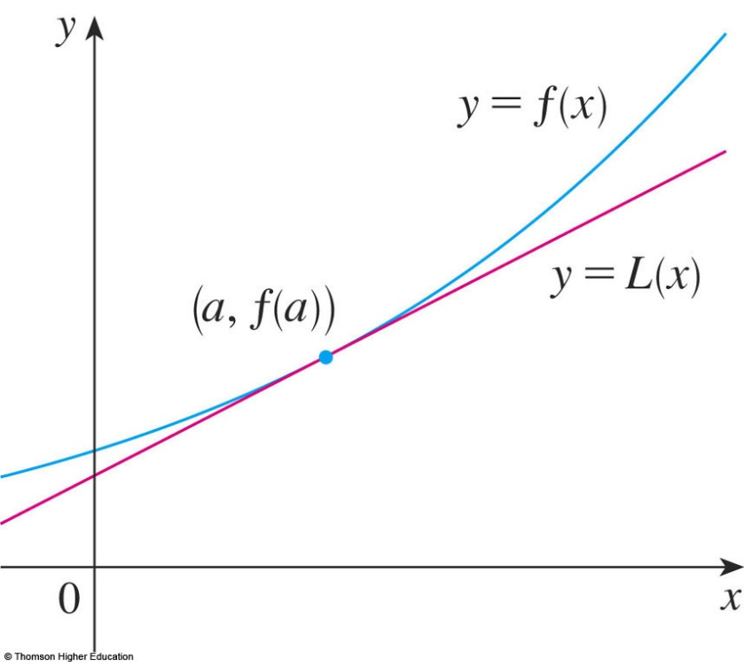
LINEAR APPROXIMATIONS
We use the tangent line at (a, f(a)) as an approximation to the curve y = f(x) when x is near a.
An equation of this tangent line is
L(x) = y = f(a) + f’(a)(x - a)

Slide 23
LINEAR APPROXIMATION
The approximation
f(x) ≈ f(a) + f’(a)(x – a) = L(x)
is called the linear approximation of f at a.

Slide 24
LINEAR APPROXIMATIONS
Example 1
Find the linearization of the function at a = 1 and use it to approximate the numbers
Are these approximations overestimates or underestimates?
Notes:
select the appropriate function, in this case such that f(x) = x^{1/2}

Slide 25
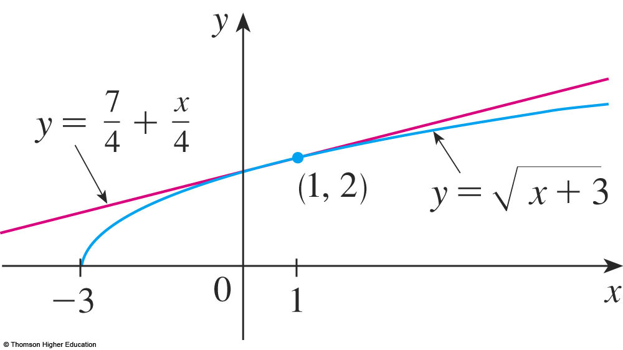
LINEAR APPROXIMATIONS
Example 1
Putting these values into Equation 2, we see that the linearization is:

Slide 26
LINEAR APPROXIMATIONS
Example 1
The corresponding linear approximation is:
(when x is near 1)
In particular, we have:

Slide 27
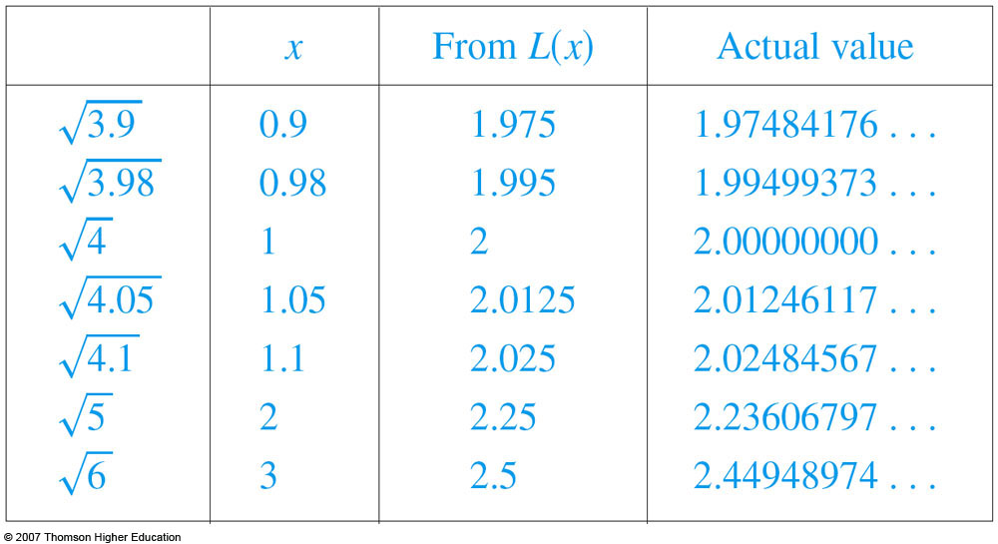
LINEAR APPROXIMATIONS
Look at the table and the figure.
The tangent line approximation gives good estimates if x is close to 1.
However, the accuracy decreases when x is farther away from 1.

Slide 28
Use the linear approximation to of the function at
a=3 to approximate the numbers. Select the correct ones.
a) b)
c) d)
Answer: a and b

Slide 29
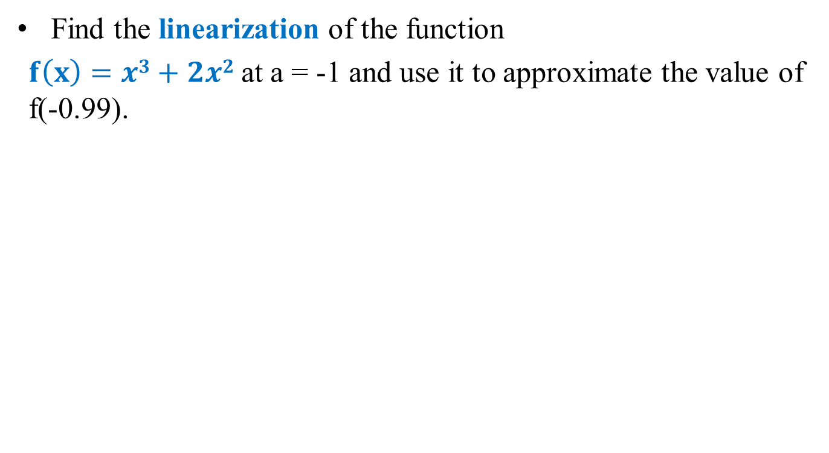
Do yourself
Find the linearization of the function
$f\left(x\right)=x3+2x2$at a = -1 and use it to approximate the value of f(-0.99).
f(x) ≈ f’(a)(x – a) + f(a) = L(x)

Slide 30
Quiz
Find the limit if
.
a. 1 b. ½ c. 1/3 d. 2
Notes:
This is (lnx)’

Slide 31
Quiz
Find when x=2 if
a. 1 b.2 c.3 d.4 e.0
Notes:
Chain rule

Slide 32
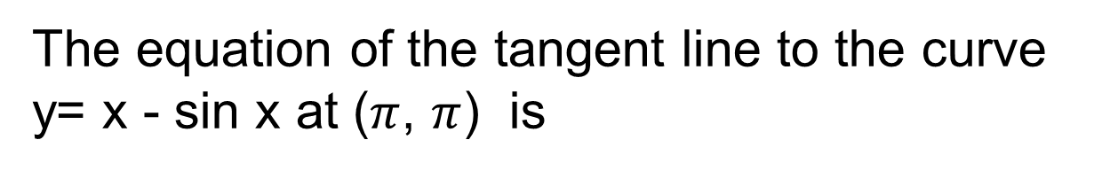
Quiz
y=0 b) y=2x c) y=2x-2
d) y=2x+2 e) None of the others
Answer: e

Slide 33
Quizzes
If 1/f =1/u+1/v then du/dv is:
f/(v-f)² b) –f²/(v-f)²
c) 2f²/(v-f)² d)-2f²/(v-f)²
e) None of the others
Answer: b

Slide 34
Exercises
P.350: 1, 2, 3, 5
P.364: 50-77

Slide 35
APPLICATIONS OF DIFFERENTIATION
4.3 Maxima and Minima
In this section, we will learn:
How to find the maximum
and minimum values of a function.
Notes:
Intuitive and precise definitions of local and absolute extreme.
The extreme value theorem.
Critical numbers, Fermat’s theorem and the closed interval method.

Slide 36
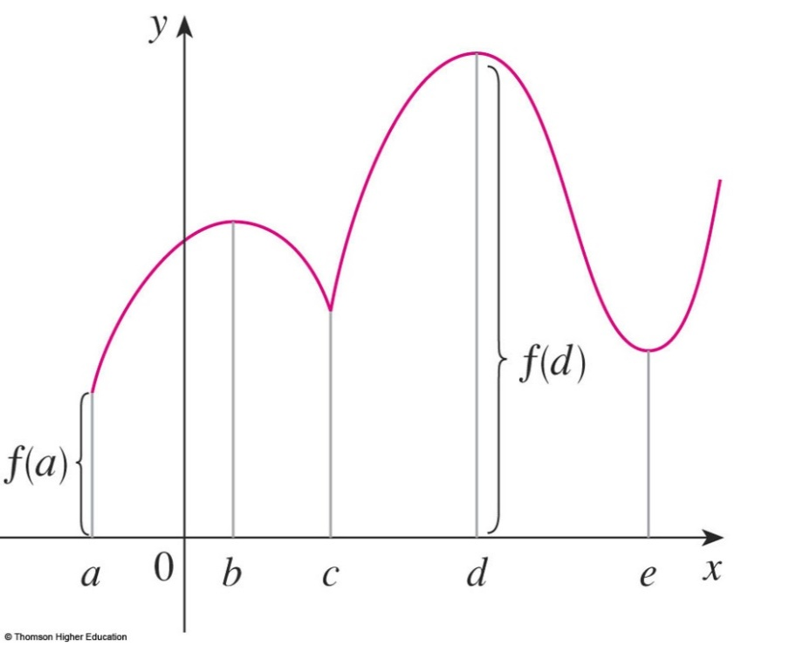
MAXIMUM & MINIMUM VALUES
Definition 1
A function f has an absolute maximum (or global maximum) at c if f(c) ≥ f(x) for all x in D, where D is the domain of f.
The number f(c) is called the maximum value of f on D.

Slide 37

MAXIMUM & MINIMUM VALUES
Definition 1
Similarly, f has an absolute minimum at c if f(c) ≤ f(x) for all x in D and the number f(c) is called the minimum value of f on D.
The maximum and minimum values of f are called the extreme values of f.

Slide 38

MAXIMUM & MINIMUM VALUES
Definition 2
A function f has a local maximum (or relative maximum) at c if f(c) ≥ f(x) when x is near c.
Similarly, f has a local minimum at c if f(c) ≤ f(x) when x is near c.

Slide 39
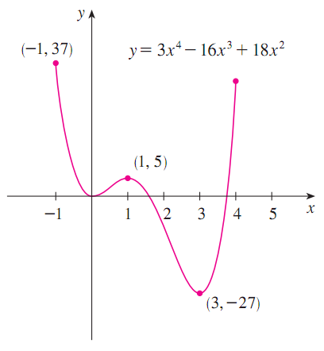
Maximum and Minimum Values (f)
(1) Absolute (global) maximum abs max
(2) Absolute (global) minimum abs min
(3) Local (relative) maximum loc max
(4) Local (relative) minimum loc min

Slide 40
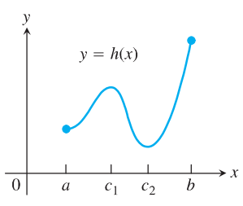
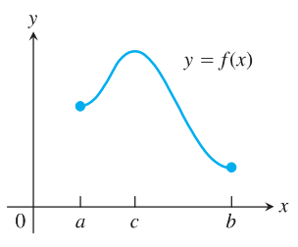
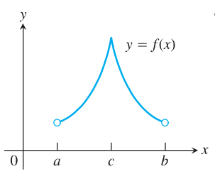
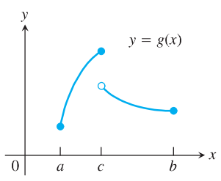
Examples
?
Abs max; abs min;
local max
Abs max; abs min;
local max; local min
Abs max;
local max;
Abs max; abs min;
local max;

Slide 41
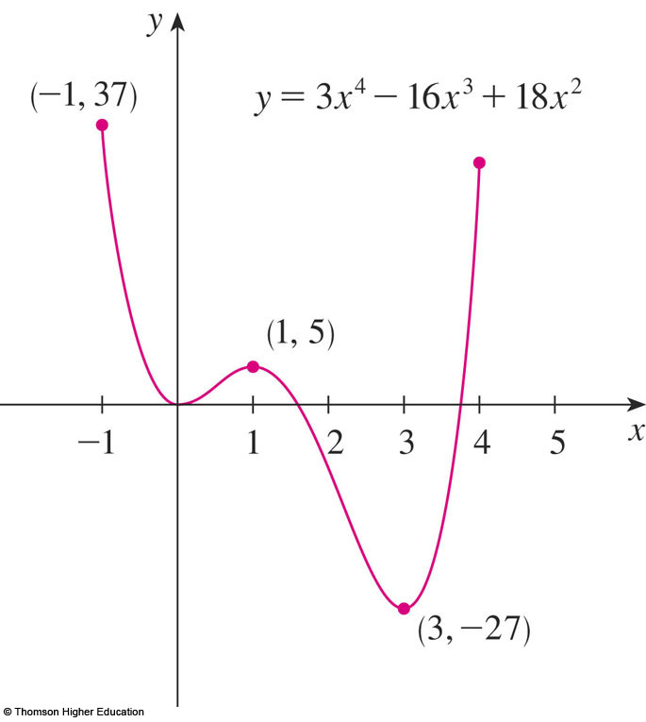
MAXIMUM & MINIMUM VALUES
Example
The graph of the function
f(x) = 3x⁴ – 16x³ + 18x², -1 ≤ x ≤ 4
is shown here.
f(1) = 5 is a local maximum
the absolute maximum is f(-1) = 37
f(0) = 0 is a local minimum and
f(3) = -27 is both a local and an absolute minimum.

Slide 42
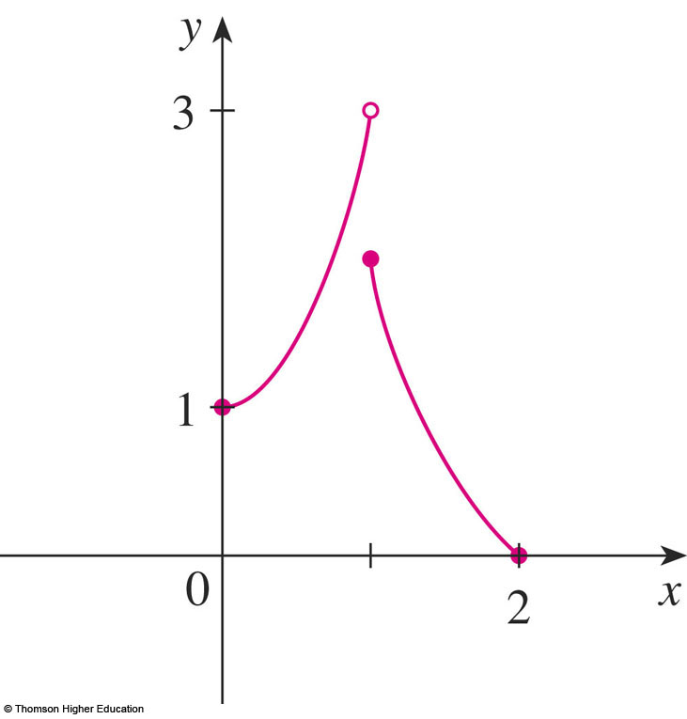
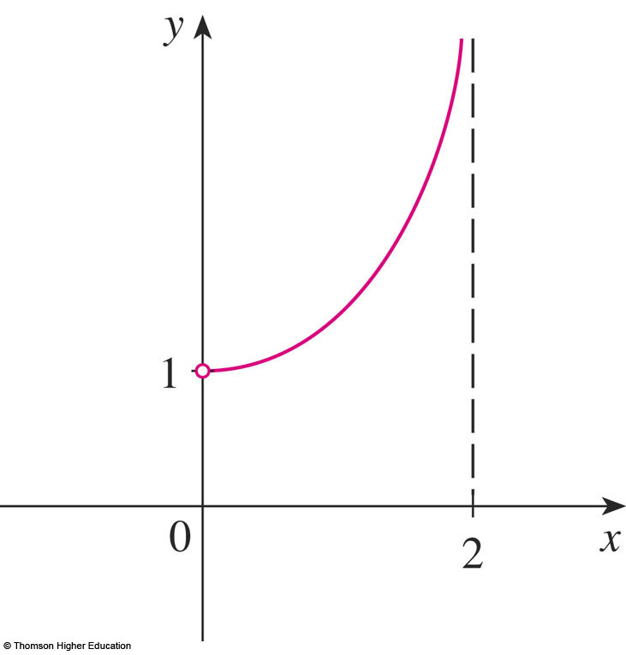
EXTREME VALUE THEOREM
In the first figure, why isn’t 3 the absolute maximum value?
In the second, does it have the absolute maximum and minimum value?

Slide 43
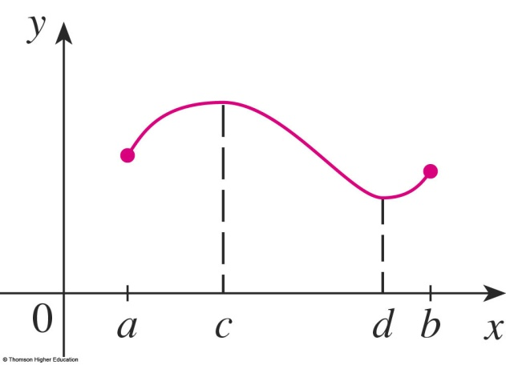
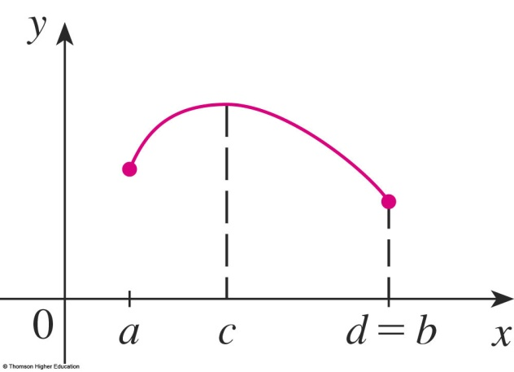
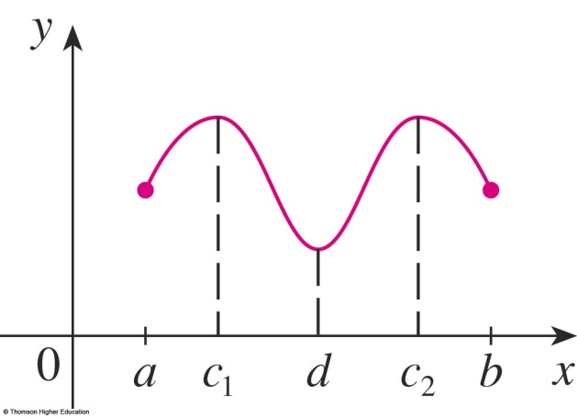
MAXIMUM & MINIMUM VALUES
Theorem
If f is continuous on a closed interval [a, b], then f attains an absolute maximum value f(c) and an absolute minimum value f(d)
at some numbers c and d in [a, b].

Slide 44
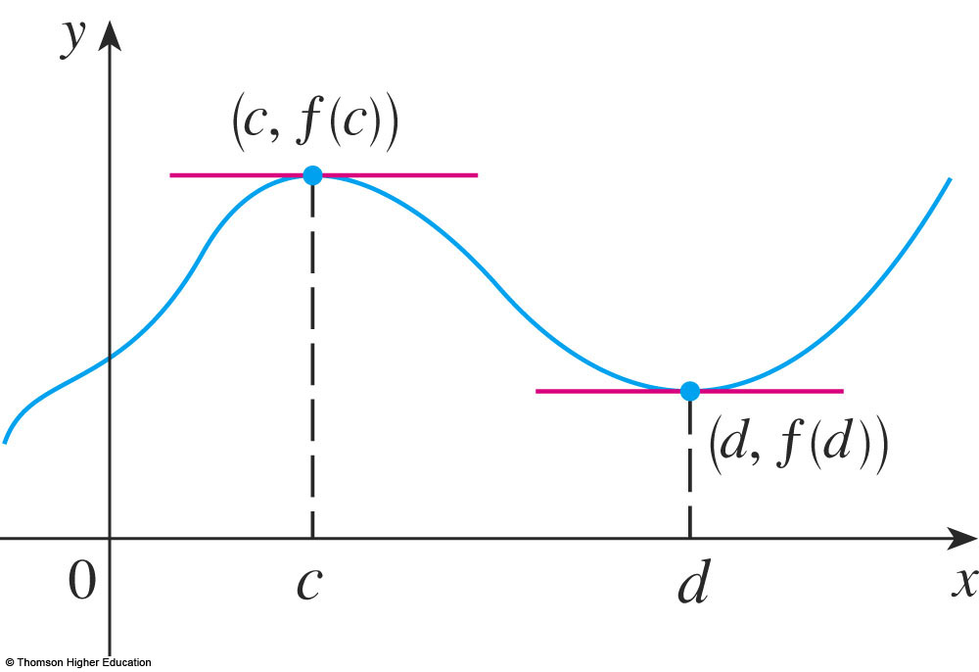
FERMAT’S THEOREM
Theorem
If f has a local maximum or minimum at c, and if f ’(c) exists, then f ’(c) = 0.

Slide 45
Is it true if say that
“f’(c)=0 if f has local extreme value at c?”
Answer: It is false, see next

Slide 46
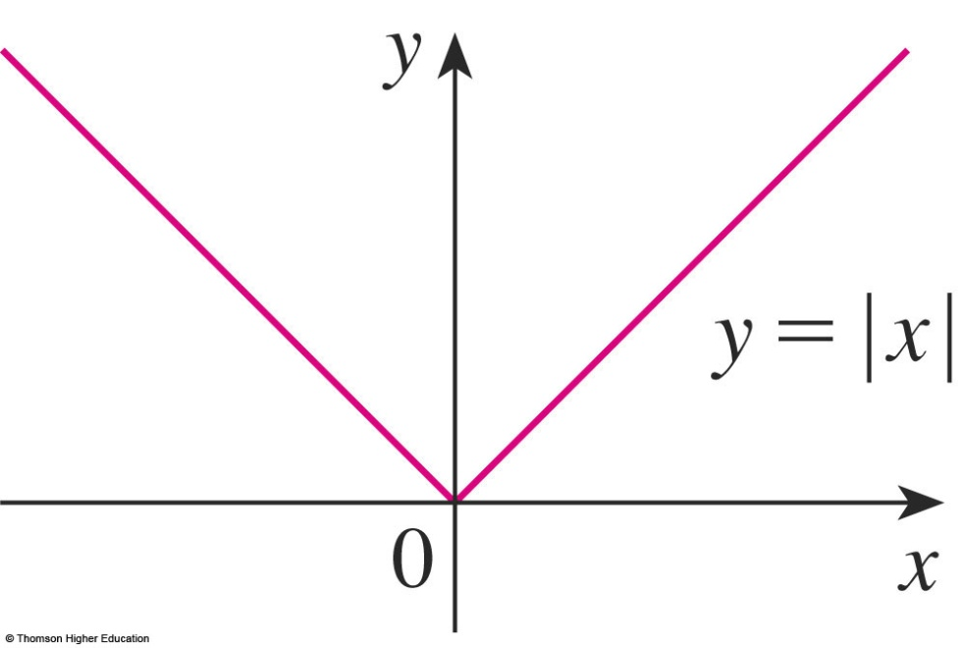
CRITICAL NUMBERS
Example
The function f(x) = |x| has its (local and absolute) minimum value at 0.
f ’(0) does not exist.

Slide 47
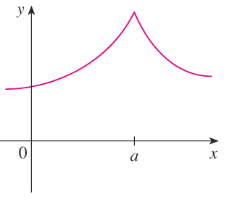

CRITICAL NUMBERS
Definition
A critical number (giá trị tới hạn)
of a function f is a number c in the domain of f such that either f ’(c) = 0 or f ’(c) does not exist.

Slide 48
CRITICAL NUMBERS
Theorem
If f has a local maximum or minimum at c, then c is a critical number of f.

Slide 49
CLOSED INTERVAL METHOD
To find the absolute maximum and minimum values of a continuous function f on a closed interval [a, b]:
Find the values of f at the critical numbers of f in (a, b).
Find the values of f at the endpoints of the interval.
The largest value from 1 and 2 is the absolute maximum value. The smallest is the absolute minimum value.
Notes:
Example: find absolute extreme for the function f(x) = (x-2)/ (x² +1) on the interval.

Slide 50
CLOSED INTERVAL METHOD
Example: find absolute extreme for the function f(x) = x³-3x²+1 on the interval [-1/2; 4].
Solution: Since is continuous on [-1/2; 4], we can use the Closed Interval Method:
f’(x) = 3x²-6x = 3x (x-2)
f’(x) = 0 <=> = 3x (x-2) = 0 => x = 0 or x = 2.
The values of f at these critical numbers are
f(0) = 1, f(2) = -3.
The values of f at the endpoints of the interval are
f(-1/2) = 1/8, f(4) = 17.
Comparing these four numbers, we see that the absolute maximum value is f(4) = 17 and the absolute minimum value is f(2) = -3.
Notes:
Example: find absolute extreme for the function f(x) = (x-2)/ (x² +1) on the interval.

Slide 51
Select the correct ones.
If f’(c)=0 then f has the local maximum or minimum at c.
If f has the absolute minimum value at c then f’(c)=0.
If f is continuous on (a,b) then f attains an absolute maximum value
f(c) and an absolute minimum value f(d) for some c and d in (a,b).
d. All of the above.
e. None of the above.
Answer: e
Notes:
a,b: If f has a local maximum or minimum at c, and if f ’(c) exists, then f ’(c) = 0.
c: [a, b]

Slide 52
APPLICATIONS OF DIFFERENTIATION
4.4 The Mean Value Theorem
In this section, we will learn about:
The significance of the mean value theorem.

Slide 53
ROLLE’S THEOREM
Let f be a function that satisfies the following three hypotheses:
f is continuous on the closed interval [a, b]
f is differentiable on the open interval (a, b)
f(a) = f(b)
Then, there is a number c in (a, b) such that f’(c) = 0.

Slide 54
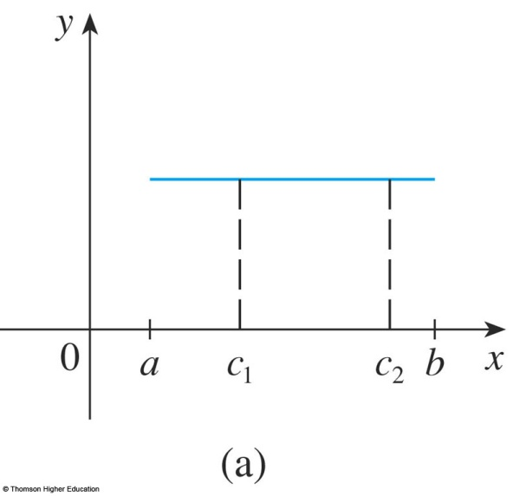
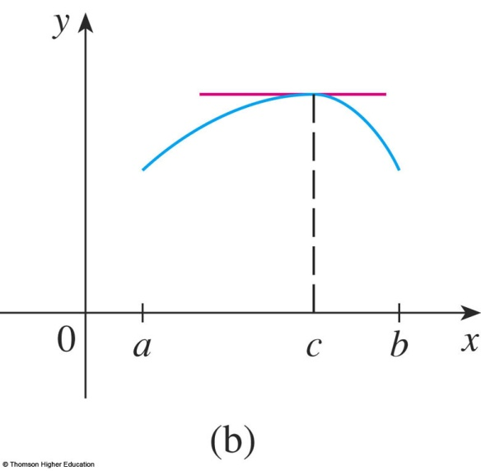
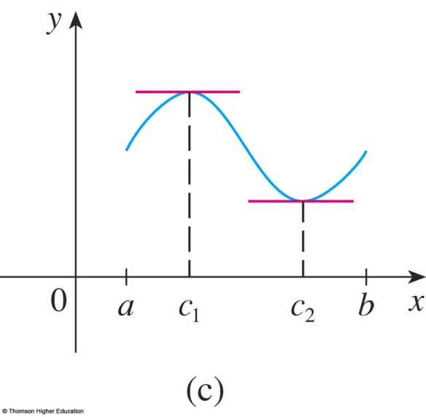
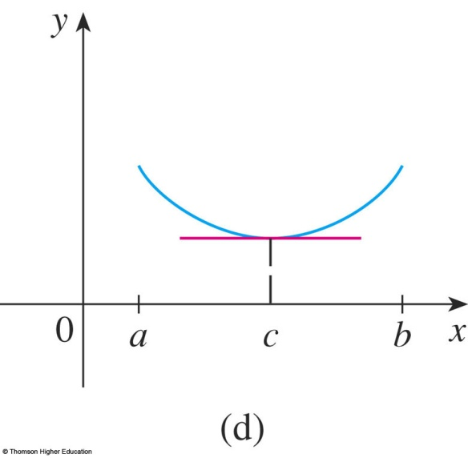
ROLLE’S THEOREM
The figures show the graphs of four such functions.

Slide 55
Let f(x)=x³-2x²+x-5. Find the numbers c in the Rolle’s theorem?
Answer: f’(c)=0 iff c=1 or c= 1/3

Slide 56
MEAN VALUE THEOREM
Equations 1 and 2
Let f be a function that fulfills two hypotheses:
f is continuous on the closed interval [a, b].
f is differentiable on the open interval (a, b).
Then, there is a number c in (a, b) such that
or, equivalently,

Slide 57
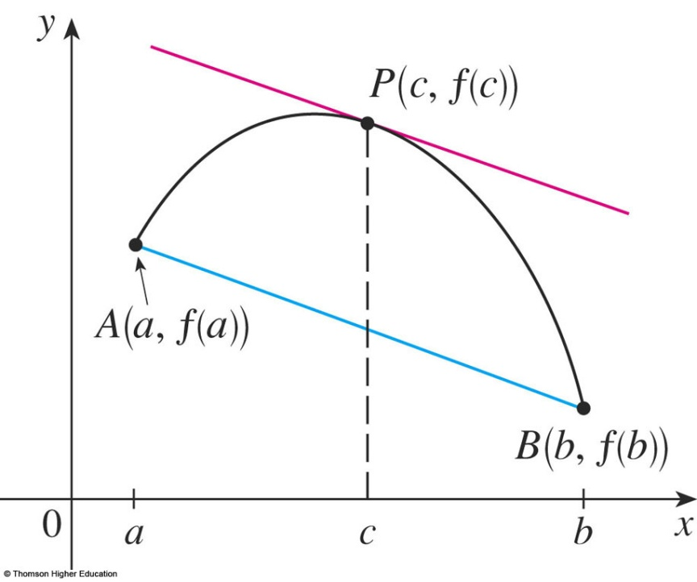
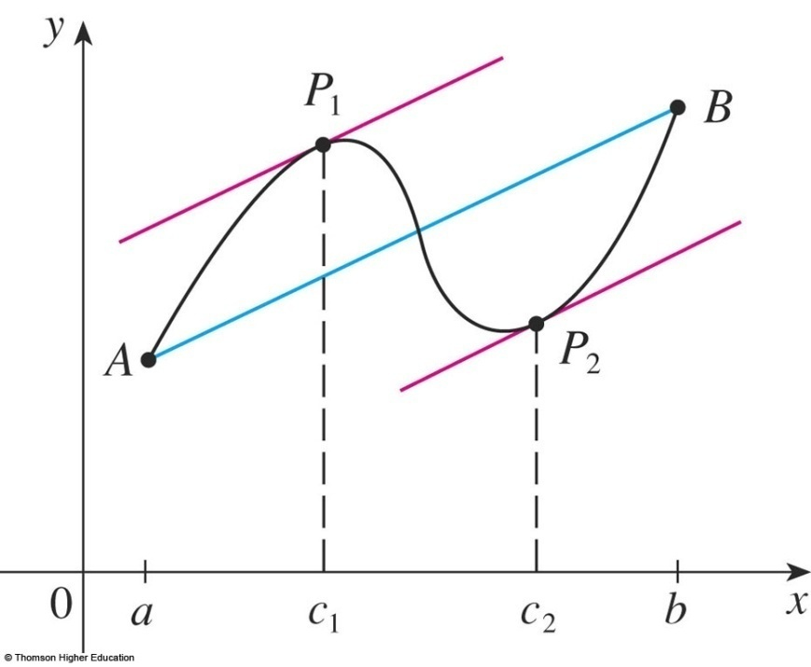
MEAN VALUE THEOREM
f ’(c) is the slope of the tangent line at (c, f(c)).
There is at least one point P(c, f(c)) on the graph where the slope of the tangent line is the same as the slope of the secant line AB.

Slide 58
Example
Suppose that f(0) = -3 and f ’(x) ≤ 5 for all values of x.
How large can f(2) possibly be?
We are given that f is differentiable - and therefore continuous - everywhere.
In particular, we can apply the Mean Value Theorem on the interval [0, 2].
There exists a number c such that f(2) – f(0) = f ’(c)(2 – 0)
So, f(2) = – 3 + 2 f ’(c)

Slide 59
Example
We are given that f ’(x) ≤ 5 ∀x
⇒ f ’(c) ≤ 5.
⇒ 2 f ’(c) ≤ 10.
⇒ f(2) = – 3 + 2 f ’(c) ≤ – 3 + 10 = 7
The largest possible value for f(2) is 7.

Slide 60
MEAN VALUE THEOREM
Theorem
If f ’(x) = 0 for all x in an interval (a, b), then f is constant on (a, b).
Corollary
If f ’(x) = g’(x) for all x in an interval (a, b), then f – g is constant on (a, b).
That is, f(x) = g(x) + c where c is a constant.

Slide 61
APPLICATIONS OF DIFFERENTIATION
4.5 Derivatives and the Shapes of Graphs
In this section, we will learn:
How the derivative of a function gives us the direction
in which the curve proceeds at each point.
Notes:
The use of the first derivative to determine whether a function is increasing or decreasing.
The first and second derivative tests for local maxima and minima.
The use of the second derivative to determine concavity and points of inflection.
The geometric description of concavity, the relationship between concavity and the behavior of the first derivative.

Slide 62
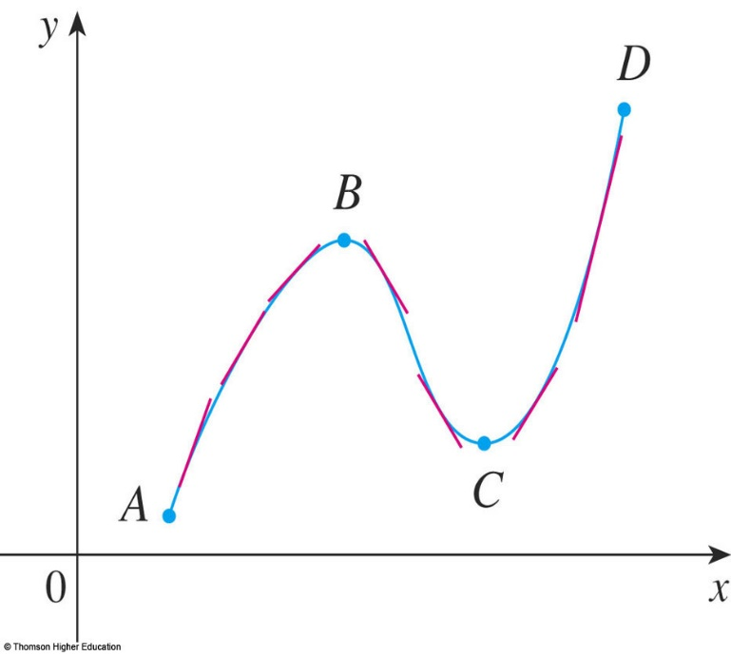
INCREASING/DECREASING TEST (I/D TEST)
If f’(x) > 0 on an interval, then f is increasing on that interval.
If f’(x) < 0 on an interval, then f is decreasing on that interval.

Slide 63
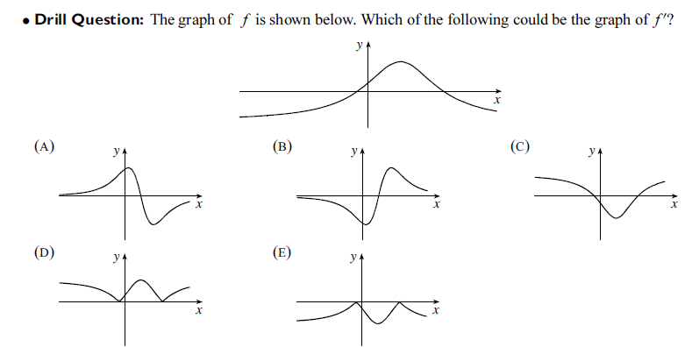
Answer: (A)
Notes:
If f(x) > 0 every x in I, the graph of its lies above x-axis.

Slide 64
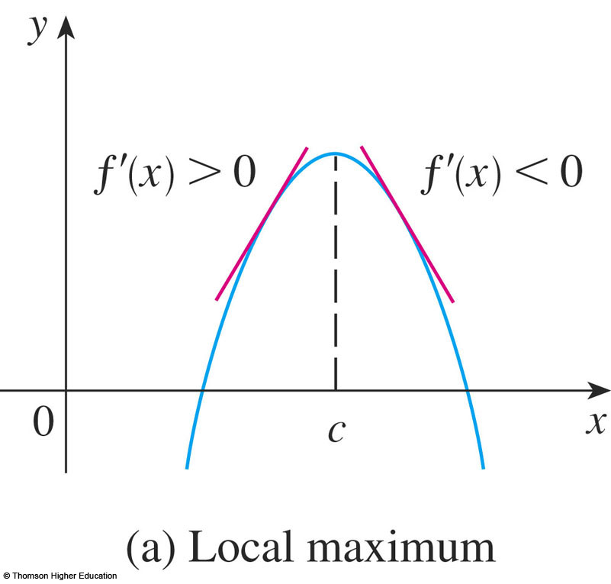
FIRST DERIVATIVE TEST
Suppose that c is a critical number of a continuous function f.
If f’ changes from positive to negative at c, then f has a local maximum at c.
Notes:
For example y = -x²

Slide 65
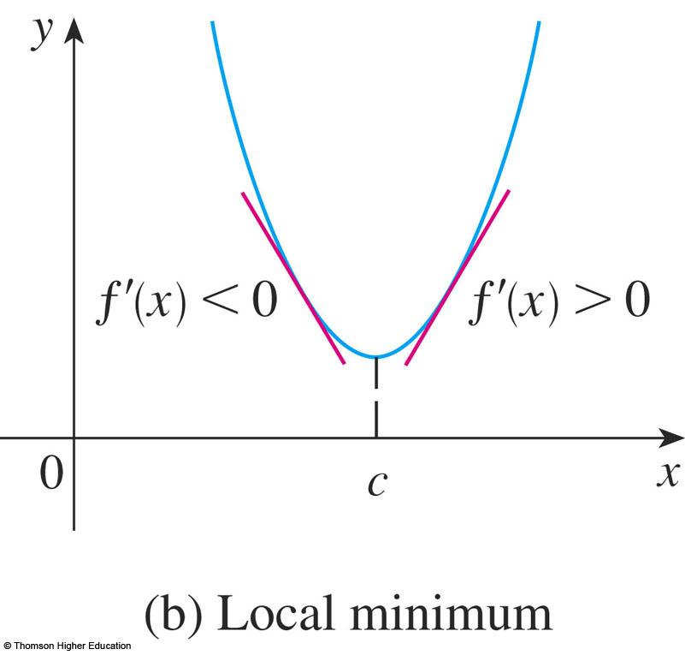
MEAN VALUE THEOREM
b. If f’ changes from negative to positive at c, then f has a local minimum at c.
Notes:
For example y=x²

Slide 66
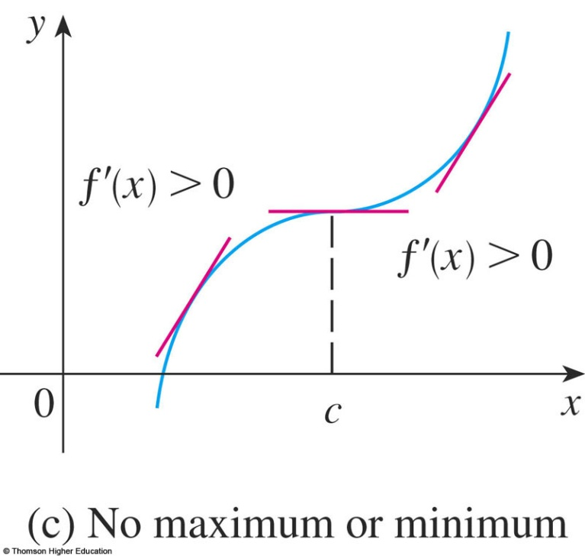
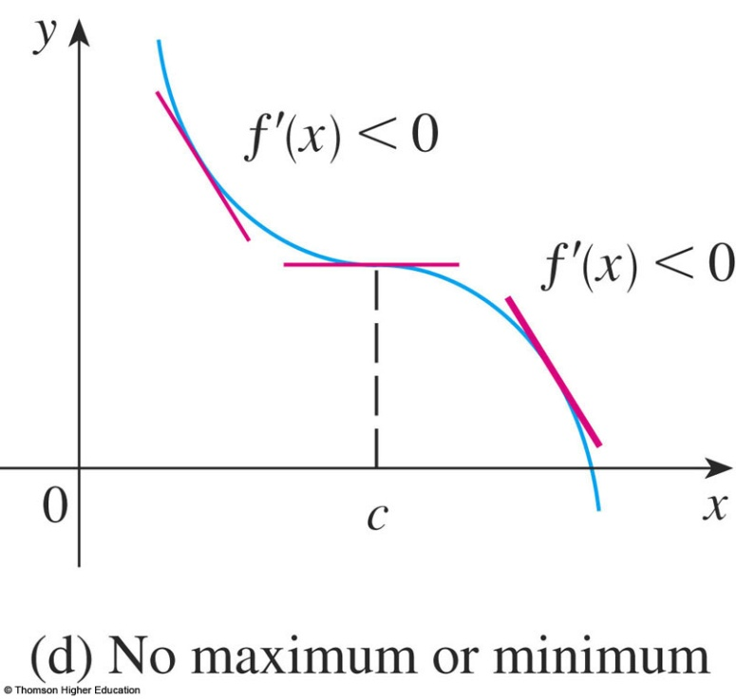
MEAN VALUE THEOREM
c. If f’ does not change sign at c then f has no local maximum or minimum at c.
Notes:
For example y=x³ ; y = -x³

Slide 67
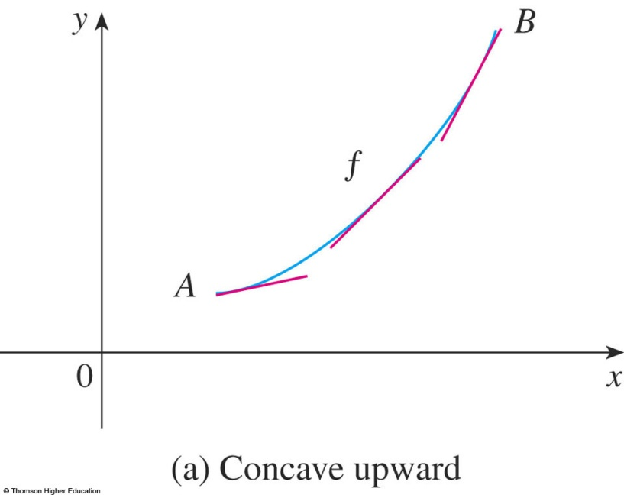
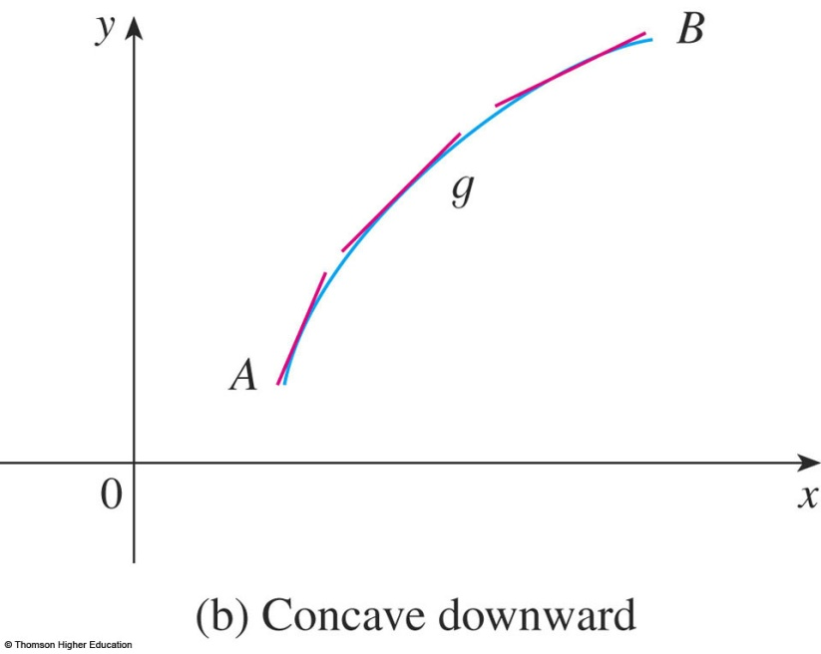
CONCAVE UPWARD/DOWNWARD
The curve lies above the tangents and f is called concave upward (lõm lên) on (a, b).
The curve lies below the tangents and g is called concave downward (lõm xuống) on (a, b).

Slide 68
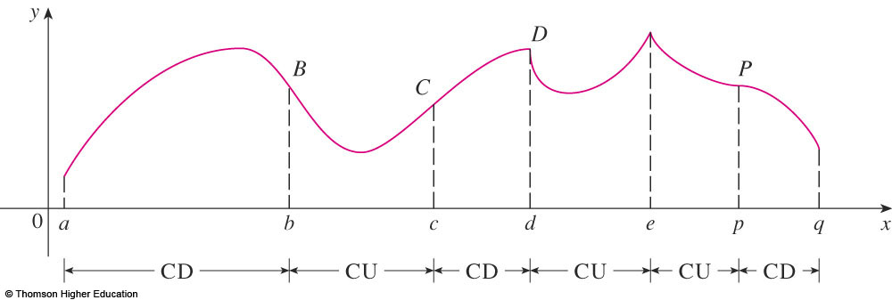
CONCAVITY TEST
If f’’(x) > 0 for all x in I, then the graph of f is concave upward on I.
If f’’(x) < 0 for all x in I, then the graph of f is concave downward on I.

Slide 69
INFLECTION POINT—DEFINITION
A point P on a curve y = f(x) is called an inflection point
if f is continuous there and the curve changes from concave upward to concave downward
(or from concave downward to concave upward at P).
Notes:
f’’(x) =0 does not imply that (x,f(x)) is an inflection point of f.
f’’ changes from positive to negative or f’’ changes from negative to positive at a value that f’’ = 0.

Slide 70
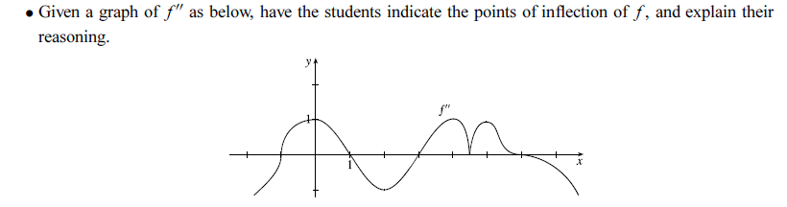
Answer: (-1,f(-1)),(1,f(1)),(3,f(3)),(6,f(6))

Slide 71
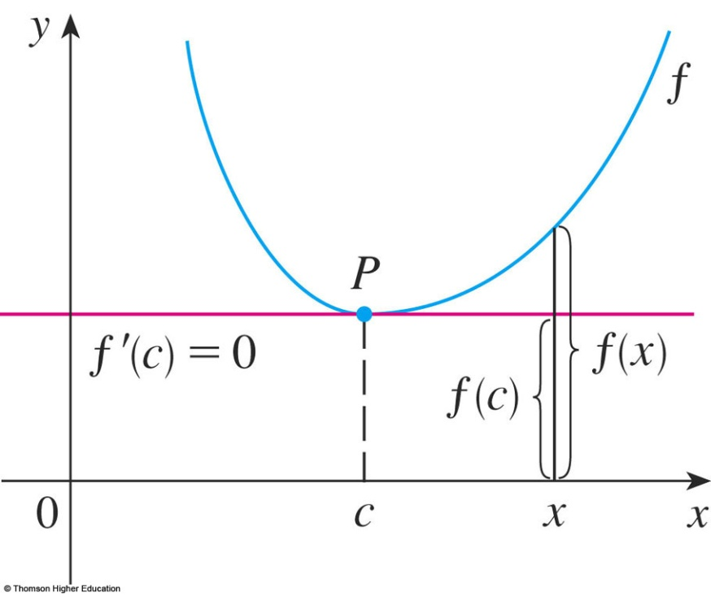
SECOND DERIVATIVE TEST
Suppose f’’ is continuous near c.
If f’(c) = 0 and f’’(c) > 0, then f has a local minimum at c.
If f’(c) = 0 and f’’(c) < 0, then f has a local maximum at c.
Notes:
Compare the First and second derivative Tests, discussing the advantages and disadvantages of using each, including an example such as f(x) = x⁵ , where the second derivative test is inconclusive and pointing out that although f’(0) = 0,, there is no local extreme there.

Slide 72
Choose the correct one.
A | If f has local extreme value at c then f’(c)=0.
B | If f’(c)=0 then f has local extreme value at c.
C | If f’’(3)=0 then (3,f(3)) is an inflection point of f.
D | There exists a function such that f’(x) is nonzero for all x and f(1)=f(0).
E | None of the above
Answer: e
Notes:
If f has a local maximum or minimum at c, and if f ’(c) exists, then f ’(c) = 0.

Slide 73
APPLICATIONS OF DIFFERENTIATION
4.6 Limit at Infinity and Asymtotes
Notes:
The method given in the text for setting up and solving optimization problems.
The various tests and closed interval method for finding absolute extreme.
Various useful techniques for simplifying computations during optimization problems, such as implicit differentiation and optimizing d² instead of the distance d to avoid the square root.

Slide 74
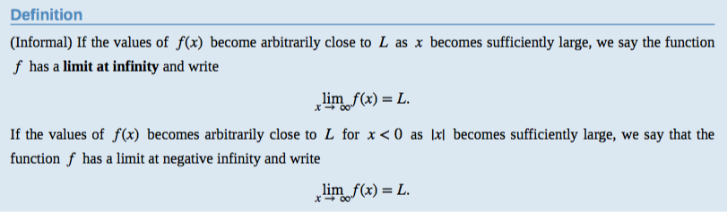
Limits at Infinity and Assymtotes

Slide 75
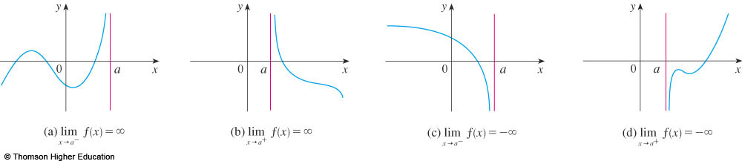
DEFINITIONS
x=a is called the vertical asymptote of f(x) if we have one of the following:
Notes:
For example

Slide 76
Limits at Infinity and Assymtotes
Example: Find the asymptotes of the function

Slide 77
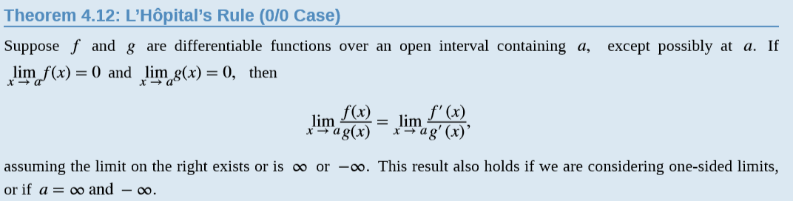
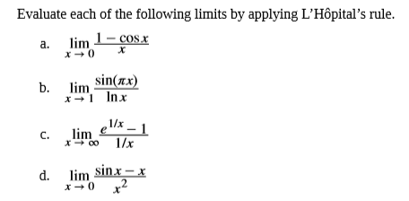
Example:

Slide 78
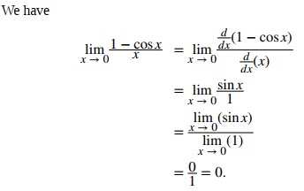
Example:

Slide 79
APPLICATIONS OF DIFFERENTIATION
4.7 Applied Optimization Problems
In this section, we will learn:
How to solve problems involving
maximization and minimization of factors.
Notes:
The method given in the text for setting up and solving optimization problems.
The various tests and closed interval method for finding absolute extreme.
Various useful techniques for simplifying computations during optimization problems, such as implicit differentiation and optimizing d² instead of the distance d to avoid the square root.

Slide 80
Find two positive numbers such that the sum is 24
and the product is the largest?
Find two positive numbers such that the product is 36
and the sum is the smallest?
Answer: 12,12, and 6,6

Slide 81
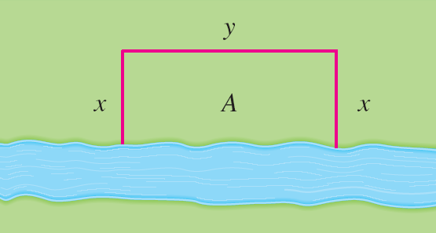
APPLIED OPTIMIZATION PROBLEMS
Example 2
A farmer has 2400 ft of fencing and wants to fence off a rectangular field that borders a straight river. He needs no fence along the river.
What are the dimensions of the field that has the largest area ?

Slide 82
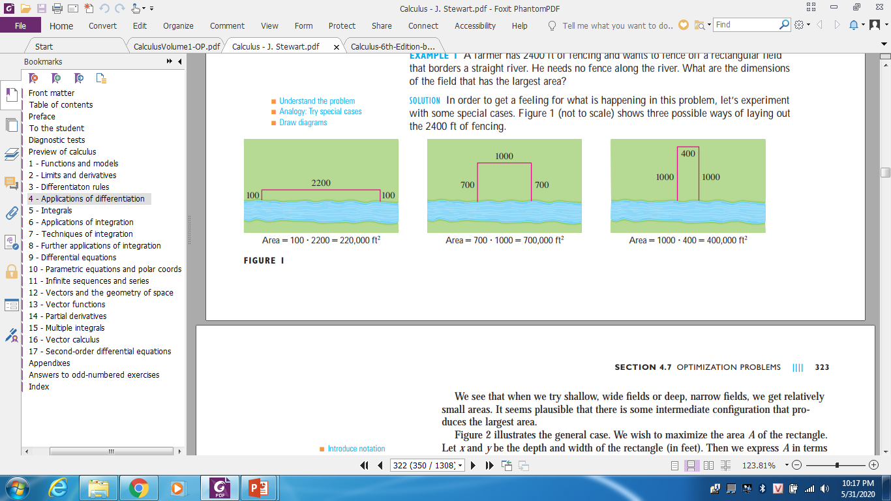
Example 2
Notes:
A1=100x2200=220.000 (ft^2)
A2=700x1000=700.000
A3=1000x400=400.000

Slide 83
APPLIED OPTIMIZATION PROBLEMS
Example
This figure illustrates the general case.
We wish to maximize the area A of the rectangle.
Then, we express A in terms of x and y: A(x,y) = xy
2x + y = 2400
So, A(x) = 2400x – 2x², 0 ≤ x ≤ 1200
A’(x) = 2400 – 4x,

Slide 84
APPLIED OPTIMIZATION PROBLEMS
Example
So to find the critical numbers we solve the equation:
2400 – 4x = 0 => x=600.
Since
A(0) = 0
A(600) = 720 000
A(1200) = 0.
Thus the rectangular field should be 600 ft deep and 1200 ft wide.

Slide 85
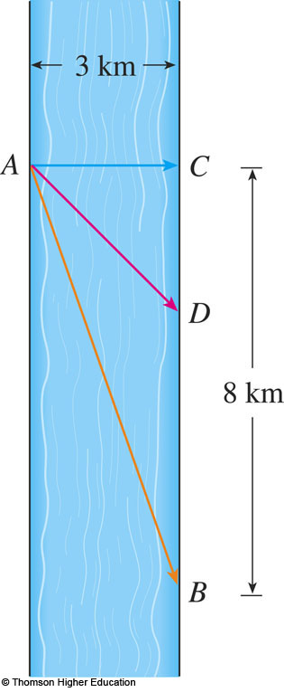
APPLIED OPTIMIZATION PROBLEMS
Example
A man launches his boat from point A on a bank of a straight river, 3 km wide, and wants to reach point B (8 km downstream on the opposite bank) as quickly as possible.
If he can row 6 km/h and run 8 km/h, where should he land to reach B as soon as possible?

Slide 86
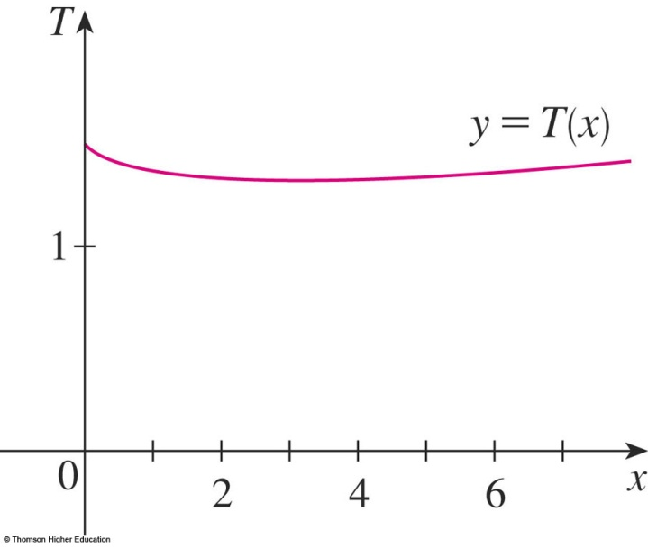
APPLIED OPTIMIZATION PROBLEMS
Example
If we let x be the distance from C to D , then the running distance is |DB| = 8 – x and the Pythagorean Theorem gives the rowing distance as |AD| =
We use the equation:
Then, the rowing time is:
The running time is: (8 – x)/8
So, the total time T as a function of x is:

Slide 87
APPLIED OPTIMIZATION PROBLEMS
Example
The domain of this function is [0, 8] .
We evaluate T at all three points:
Thus the man should land the boat at a point km ( km) downstream from his starting point .

Slide 88
APPLICATIONS OF DIFFERENTIATION
4.9 Newton’s Method
In this section, we will learn:
How to solve high-degree equations
using Newton’s method.
Notes:
Newton’s method and its uses.
Geometric interpretation of Newton’s method.
The speed of approximation of Newton’s method.

Slide 89
NUMERICAL ROOTFINDERS
How do those numerical root finders work?
They use a variety of methods.
Most, though, make some use of Newton’s method, also called the Newton-Raphson method.

Slide 90

NEWTON’S METHOD
We start with a first approximation x_{1,} which is obtained by one of the following methods:
Guessing
A rough sketch of the graph of f
A computer- generated graph of f
Notes:
How do you do know what to choose as x₁ ?

Slide 91

NEWTON’S METHOD
Consider the tangent line L to the curve y = f(x) at the point (x₁, f(x₁)) and look at the x-intercept of L, labeled x₂.

Slide 92
SECOND APPROXIMATION
As the x-intercept of L is x₂, we set y = 0 and obtain:
0 - f(x₁) = f’(x₁)(x₂ - x₁)
If f’(x₁) ≠ 0, we can solve this equation for x₂:
We use x₂ as a second approximation to r.

Slide 93

SUBSEQUENT APPROXIMATION
In general, if the nth approximation is x_{n} and f’(x_{n}) ≠ 0, then the next approximation is given by:

Slide 94

CONVERGENCE
If the numbers x_{n} become closer and closer to r as n becomes large, then we say that the sequence converges to r and we write:

Slide 95
NEWTON’S METHOD
Example
Starting with x₁ =2 , find the third approximation to the root of the equation x³ – 2x – 5 = 0.
SOLUTION We apply Newton’s method with
We have

Slide 96
NEWTON’S METHOD
Example
Use Newton’s method to find correct to eight decimal places.
First, we observe that finding is equivalent to finding the positive root of the equation x⁶ – 2 = 0
So, we take f(x) = x⁶ – 2
Then, f’(x) = 6x⁵

Slide 97
NEWTON’S METHOD
Example
So, Formula 2 (Newton’s method) becomes:

Slide 98
NEWTON’S METHOD
Example
Choosing x₁ = 1 as the initial approximation, we obtain:
As x₅ and x₆ agree to eight decimal places, we conclude that to eight decimal places.

Slide 99


Slide 100
APPLICATIONS OF DIFFERENTIATION
4.10 Antiderivatives
In this section, we will learn about:
Antiderivatives and how they are useful
in solving certain scientific problems.
Notes:
Anti derivatives with and without initial conditions.
Position, velocity and acceleration.

Slide 101
Definition
A function F is called an antiderivative of f on an interval I if F’(x) = f(x) for all x in I.

Slide 102
ANTIDERIVATIVES
Theorem
If F is an antiderivative of f on an interval I, the most general antiderivative of f on I is
F(x) + C
where C is an arbitrary constant.

Slide 103

ANTIDERIVATIVE FORMULA
Here, we list some particular antiderivatives.

Slide 104
RECTILINEAR MOTION
Example
A particle moves in a straight line and has acceleration given by a(t) = 6t + 4.
Its initial velocity is v(0) = -6 cm/s and its initial displacement is s(0) = 9 cm.
Find its position function s(t).

Slide 105


Example

Slide 106
A particle moves along the x-axis so that its velocity at time t is given by 3 sin 2t.
Assuming it starts at the origin, where is it at t = π seconds?
a. 0 b. 3/2 c. ½ d. - 1/2
Answer: a

Slide 107
Summary
Maximum and Minimum Values
The Mean Value Theorem
f’ and f’’ say about f
Optimization Problems
Newton’s Method
Anti-derivatives

